Slide 1
Introduction to Tableau
USCOTS 2017 workshop: web scraping and data visualization with Python and Tableau

Slide 2
Why Tableau?
It can connect to a variety of data sources
Local Excel, csv, tab-delimited data files
Data servers
Statistical files including R, SAS, and SPSS data files
It facilitates interactive data exploration and visualizations
It requires very little programming knowledge (none if you are using basic functionalities)
Visualizations can be “published” online and shared via blogs or other websites

Slide 3
Versions
Tableau Public
Free!
Workbooks are saved on Tableau Public’s server rather than locally
Tableau Desktop
Can save workbooks locally
More available data sources
Expensive in general, but free to faculty/students of accredited universities

Slide 4
What Tableau is NOT….
A data management tool! Essentially limited to…
New variable creation
Filtering
R, Python, JMP are much better for heavy ‘data wrangling’
Reshaping (wide to long to wide)
Complicated aggregation
Do your heavy-duty cleaning outside Tableau; save to .csv or data file of choice

Slide 5
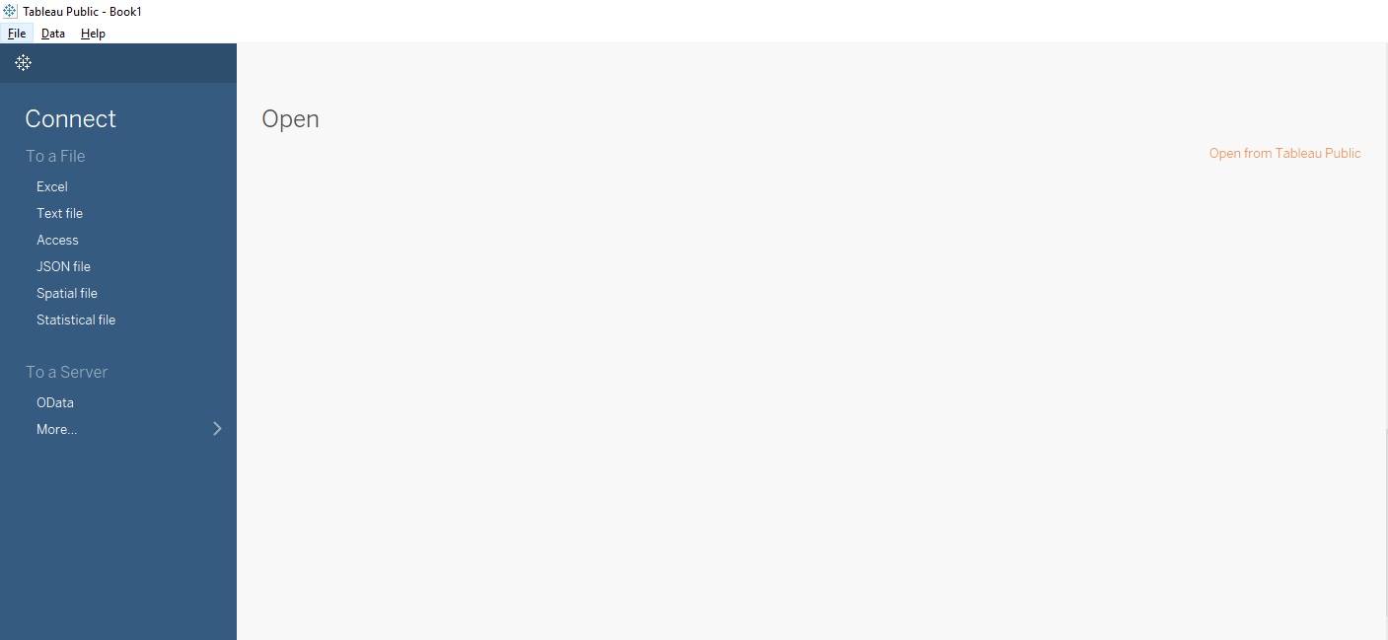
Let’s get started!
The first time you open Tableau, you will see the “Home Page”:
Connect to the WorldBankIndicators.csv file, by clicking on the “Text File” option

Slide 6
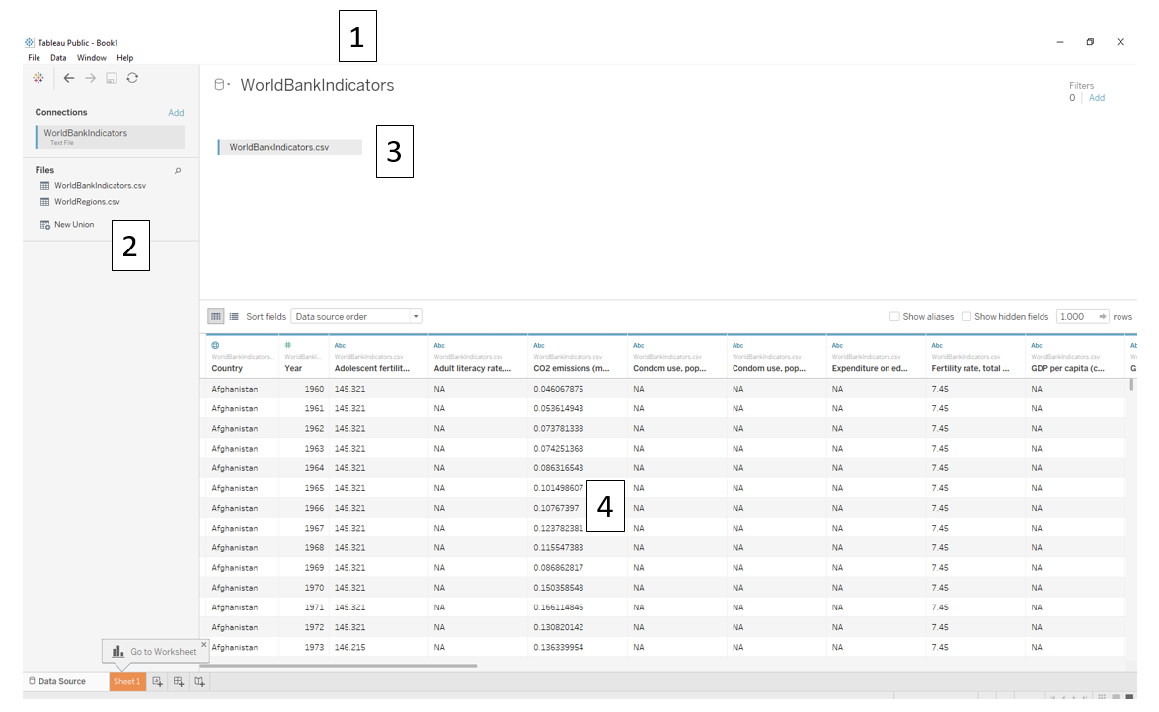
The data file you are currently connected to. Click to rename it within Tableau.
Data sheets in the same working directory of the same file extension.
This is also where names of multiple sheets will show up, if you connect to an Excel file with multiple tabs.
The data sheets you want to visualize: you can click-and-drag sheets from “2” into this space to link multiple data sources.
A view of your data.

Slide 7
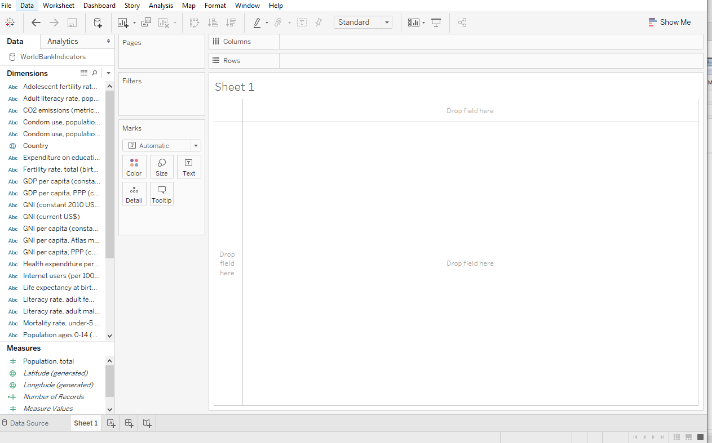
Click on “Sheet 1”:

Slide 8
Tableau vocabulary
Fields
I.e., “variables”; “data columns”
Axes are determined by whether fields are Discrete or Continuous
Aka Categorical or Quantitative
Discrete fields create headers, or discrete bins. Blue pills.
Continuous fields create continuous AXES. Green pills
Aggregation determined by whether fields are MEASURES or DIMENSIONS
Dimensions by default are NOT AGGREGATED
Measures by default are AGGREGATED (summed, averaged, etc.)

Slide 9
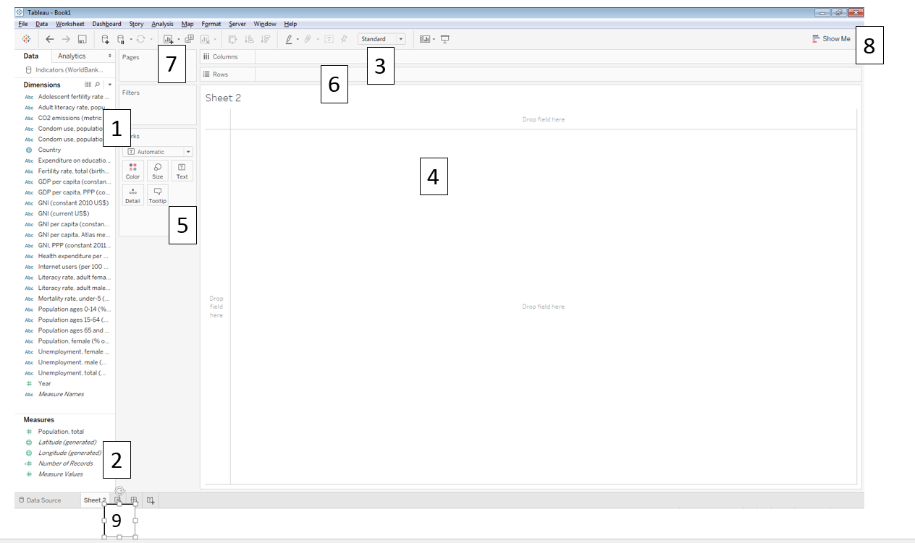
Back to the view:
All the dimensions in the data set
All the measures in the data set
Columns and Rows shelves: controls grouping (for Dimensions) and axes (for Measures).
The “canvas”, where visualizations appear. You can drag variables here instead of the Columns and Rows shelves.
The Marks card: this controls colors, shapes, sizes, labels, etc.
The Filters shelf: filter visualizations by field
The Pages shelf: filters by animating
The “Show Me” card: this is kind of like a “shortcut” card, and allows you to view available visualizations for selected fields.
All Worksheets, Dashboards, and Stories currently in use; and buttons for new Worksheets/Dashboards/Stories.

Slide 10
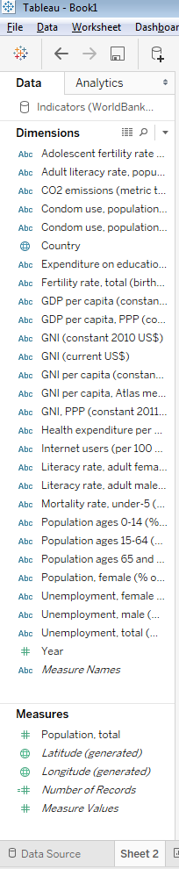
Note some fields not in the original data set:
Measure Names: Contains all the field names of the measures.
Vector of strings, containing all the names of the measures
In this case, Measure Names contains the strings
Number of Records: Essentially a column of 1’s
Very useful for counting rows
Measure Values: All the numeric values of all measures.
Super long vector, with all data values of measures in the data set
Useful for blending multiple fields in the same graph
Latitude, Longitude: automatically generated if there is a geographic field (Country, here)

Slide 11
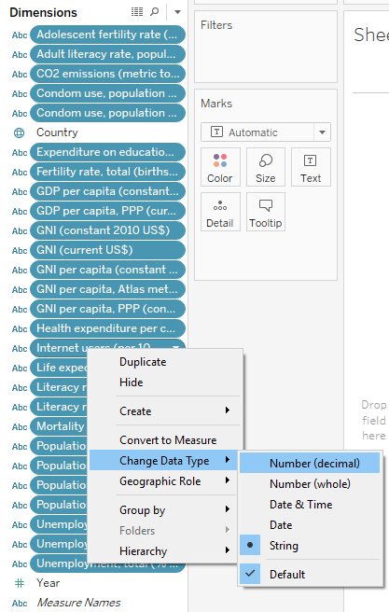
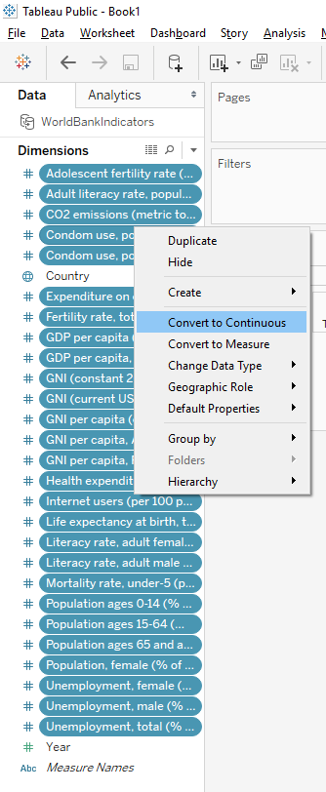
Tableau is usually good at guessing whether fields should be discrete or continuous
All the ‘quantitative’ fields in the .csv file contained NAs, which were interpreted as strings
Change these to decimals, then to continuous, by highlighting and right-clicking:

Slide 12
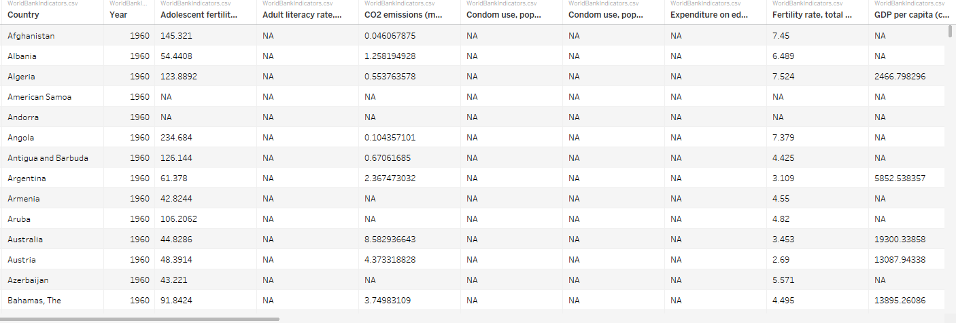
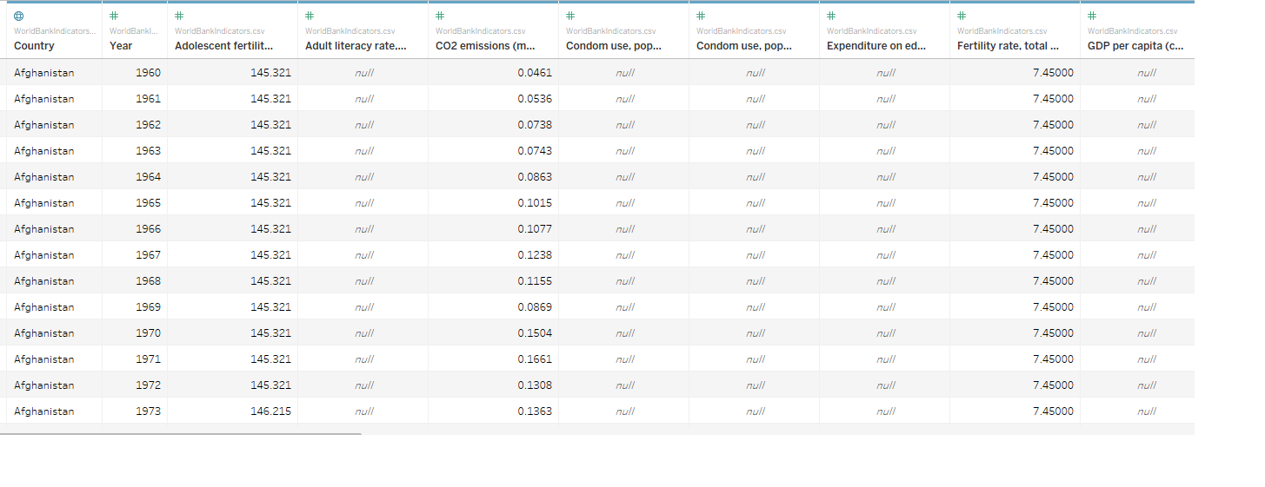
Note how this changes the way the missing values are interpreted, and format of decimals
Fields as discrete strings
Fields as continuous decimals
(NAs appropriately recognized as such)

Slide 13
Save this workbook for later…we’ll come back to it!

